Slide 1



A CENTER FOR INTER-DISCIPLINARY RESEARCH
2021-22
TITLE
“Artisanate”
SUPERVISED BY
Harshavardhini Kyatam
GOKARAJU RANGARAJU
INSTITUTE OF ENGINEERING AND TECHNOLOGY
AUTONOMOUS

Slide 2
Advanced Academic Center
( A Center For Inter-Disciplinary Research )
This is to certify that the project titled
“Artisanate”
is a bonafide work carried out by the following students in partial fulfilment of the requirements for Advanced Academic Center intern, submitted to the chair, AAC during the academic year 2021-22.

Slide 3
NAME | ROLL N0 | BRANCH
SOWMYA CHOWDARY NANDIGUM | 21241A3238 | CSBS
SAI DEEPIKA PALACHARLA | 21241A3253 | CSBS
REDDISHETTI DANISH | 21241A05X0 | CSE
SAI ABHINAV GOUD | 21241A66J3 | AIML
CHEPURI SIDDHI GANESH | 21241A1214 | IT
This work was not submitted or published earlier for any study
Dr/Ms./Mr.
Dr.B.R.K.Reddy
Program Coordinator
Dr. G. Ramesh
Dean, AAC
Project Supervisor

Slide 4
ACKNOWLEDGEMENTS
We express our deep sense of gratitude to our respected Director, Gokaraju Rangaraju Institute of Engineering and Technology, for the valuable guidance and for permitting us to carry out this project.
With immense pleasure, we extend our appreciation to our respected Principal, for permitting us to carry out this project.
We are thankful to the Associate Dean, Advanced Academic Centre, for providing us an appropriate environment required for the project completion.
We are grateful to our project supervisor who spared valuable time to influence us with their novel insights.
We are indebted to all the above mentioned people without whom we would not have concluded the project.

Slide 5
Abstract
Abstract The drivers for electronic commerce are both technological (under the tremendous pressure of innovation) and business oriented. This paper will highlight some guidelines for companies who are entering into E-commerce to create an E-commerce strategy or who already have an E-commerce presence to revise their existing strategy .
Artisanate is an ecommerce website developed for introducing local market to online market. This website emphasizes on handmade good such as earrings ,bags ,scented candles ,chains ,bracelets ,rings , handloom sarees . Customer can buy the products they desire directly from the cart and with the cash on delivery, the amount is paid directly to the producer. This makes sure both the user and the vendor are benefited with reasonable prices of the products.This website acts as an interface between producer and the customer.The business-to-consumer aspect of product commerce (e-commerce) is the most visible business use of the World Wide Web. The primary goal of an e-commerce site is to sell goods online.

Slide 6
Introduction
Artisanate is an ecommerce website developed for intoducing local market to online market.This website emphasizes on handmade goods such as earings,bags,scented candles,chains,bracelets,rings,handloom sarees. Customer can buy the products they desire directly from the cart and with the cash on delivery, the amount is paid directly to the producer. This makes sure both the user and the vendor are benefited with reasonable prices of the products.
This website acts as an interface between producer and the customer. The project objective is to deliver the online shopping application into android platform.Online shopping is the process whereby consumers directly buy goods or services from a seller in real-time, without an intermediary service, over the Internet. It is a form of electronic commerce. This project is an attempt to provide the advantages of online shopping to customers of a real shop. It helps buying the products in the shop anywhere through internet by using an android device. Thus the customer will get the service of online shopping and home delivery from his favorite shop.
project work flow
You can either search or select the categories present in the website.Once you open the category page you will be able to see variety of products available for selection.You can select the product you desire and add to cart.once you choose all the items you will be able to proceed the payment from add to cart page.The payment needs to be done using cash on delivery.

Slide 7
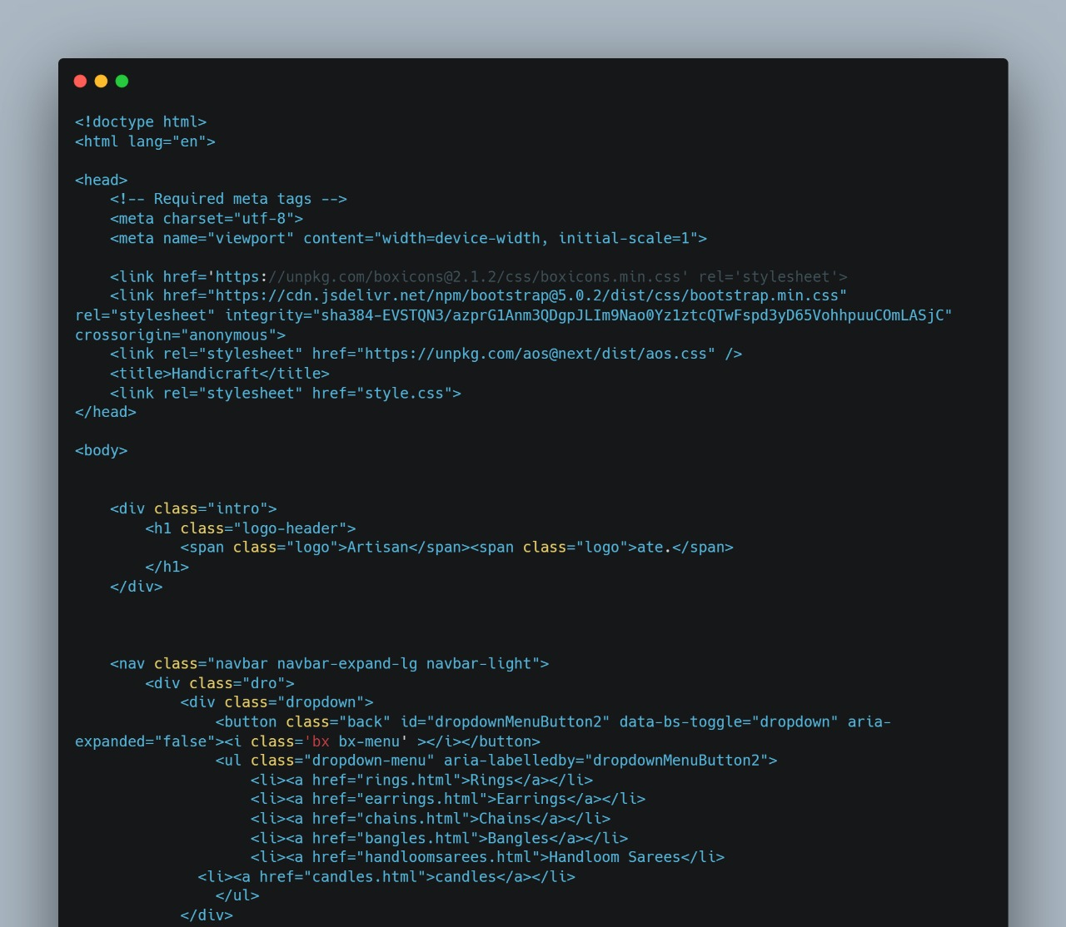
code

Slide 8
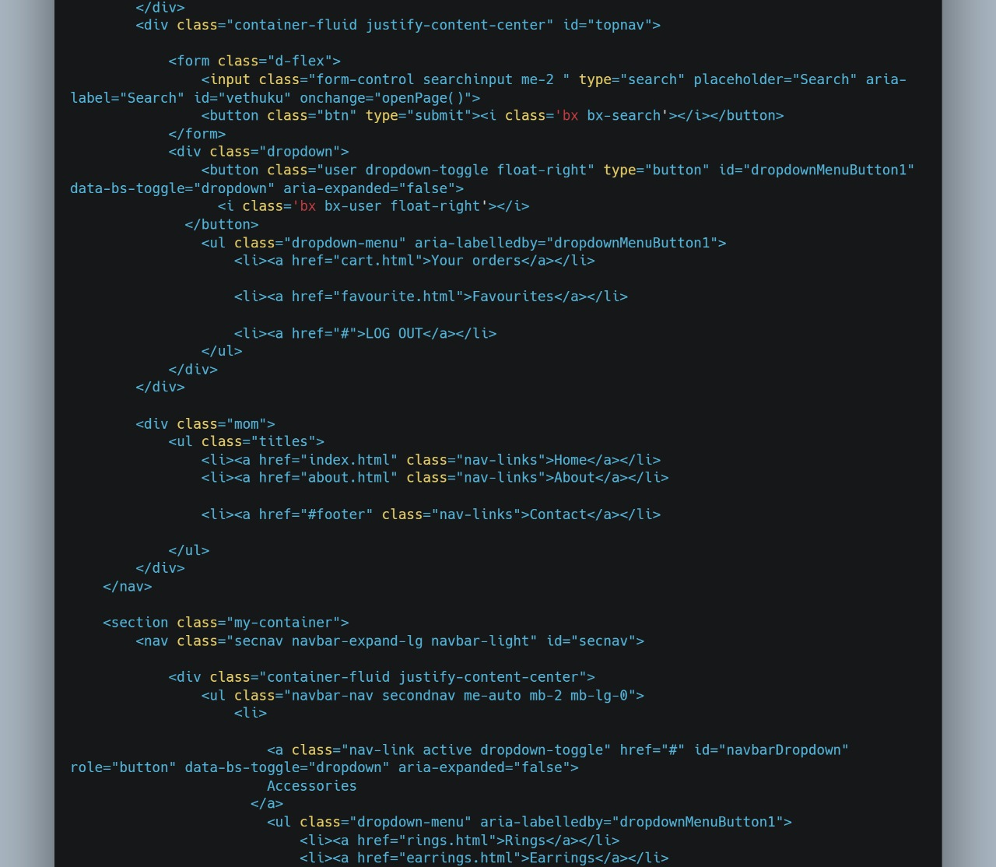

Slide 9
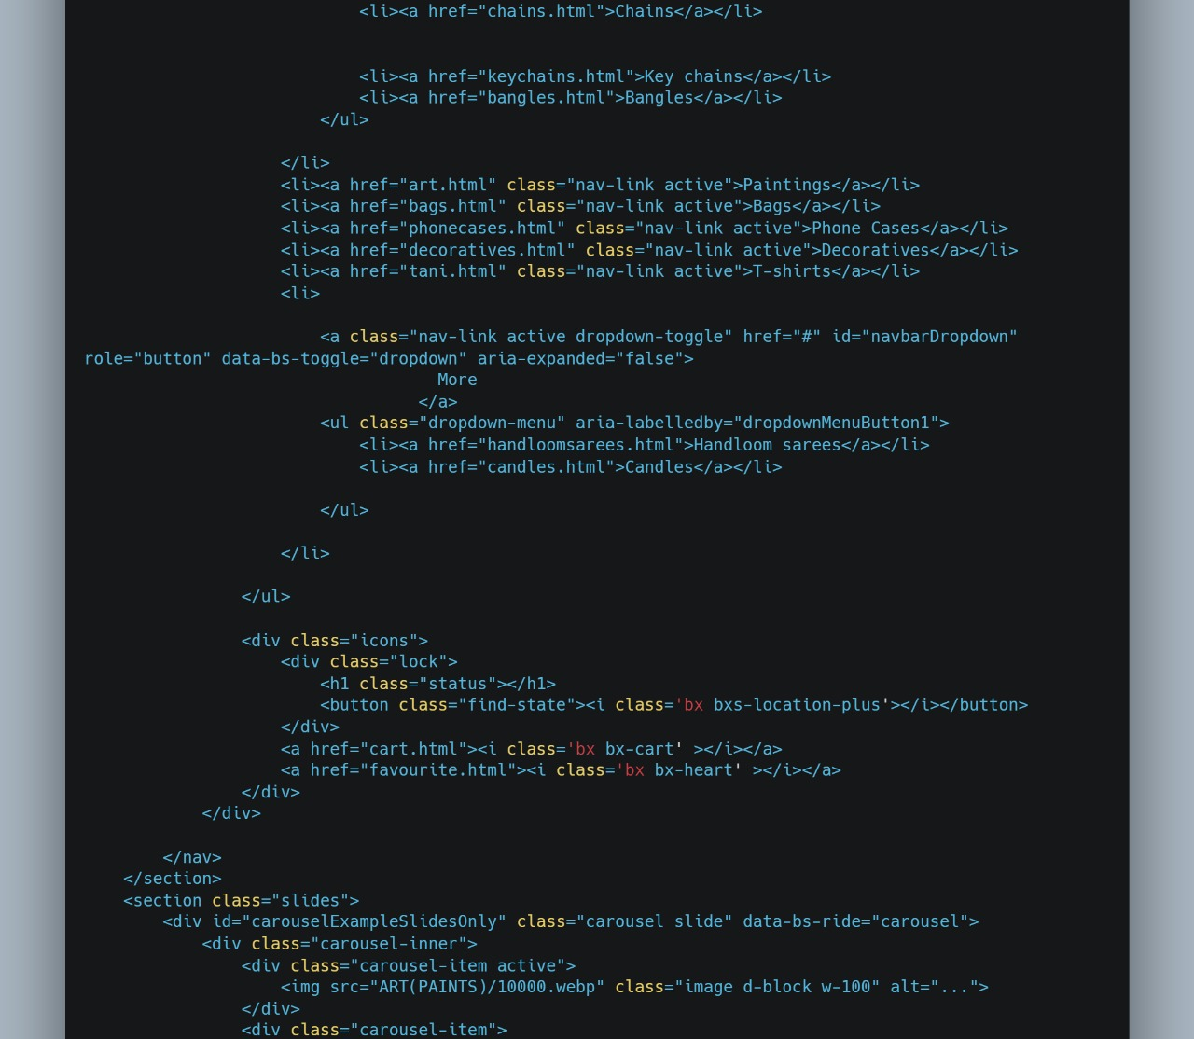

Slide 10
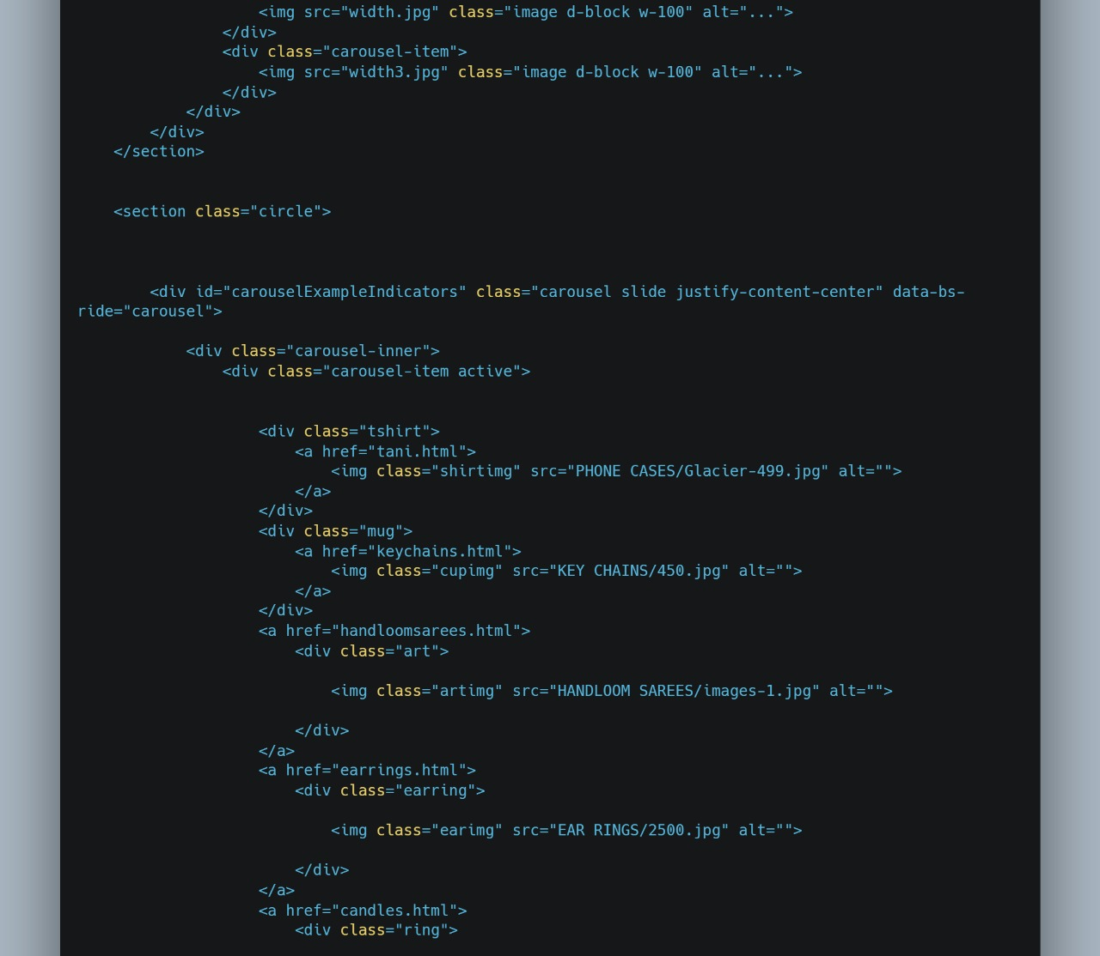

Slide 11
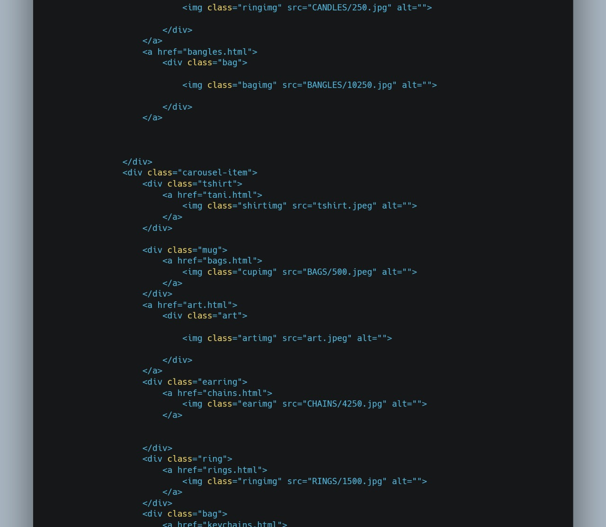

Slide 12
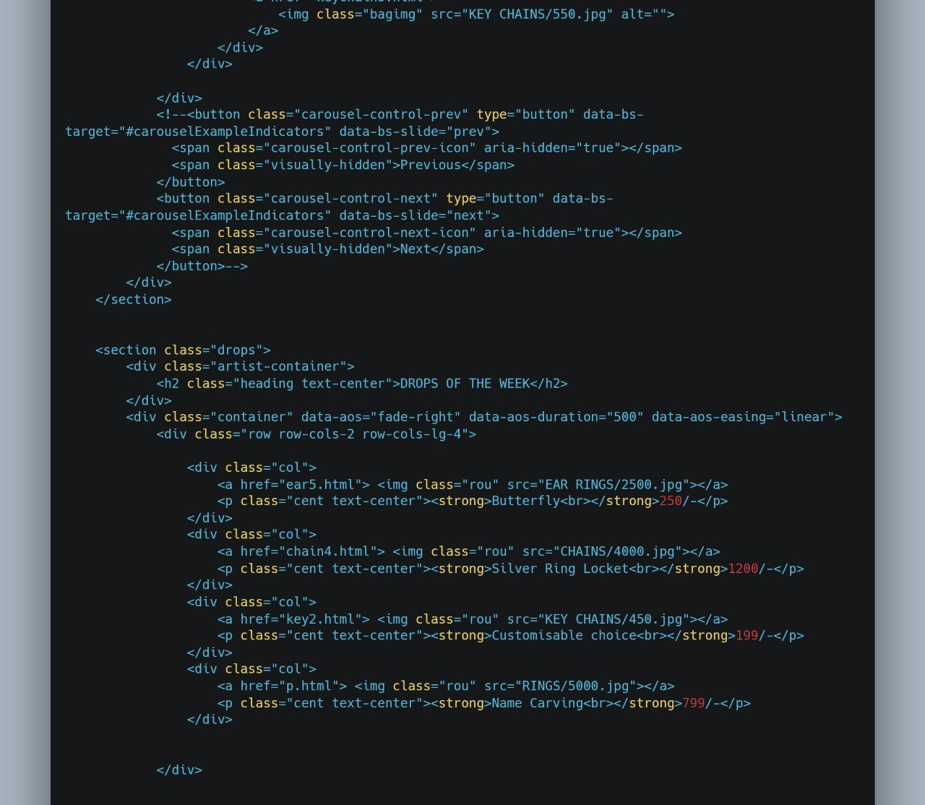

Slide 13
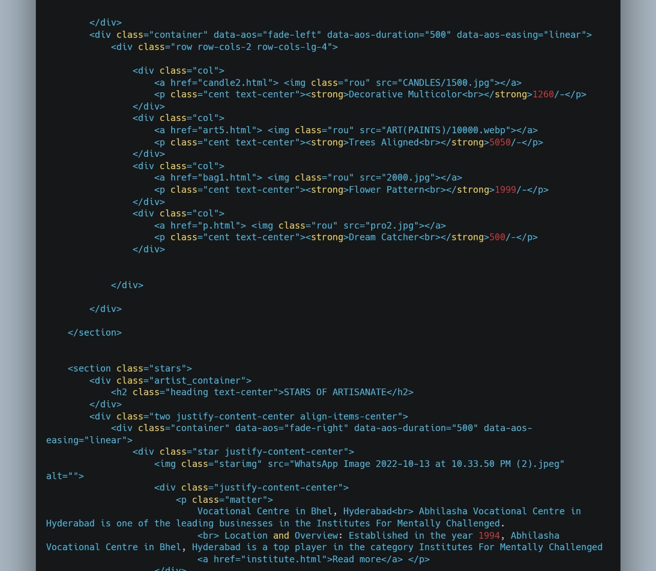

Slide 14
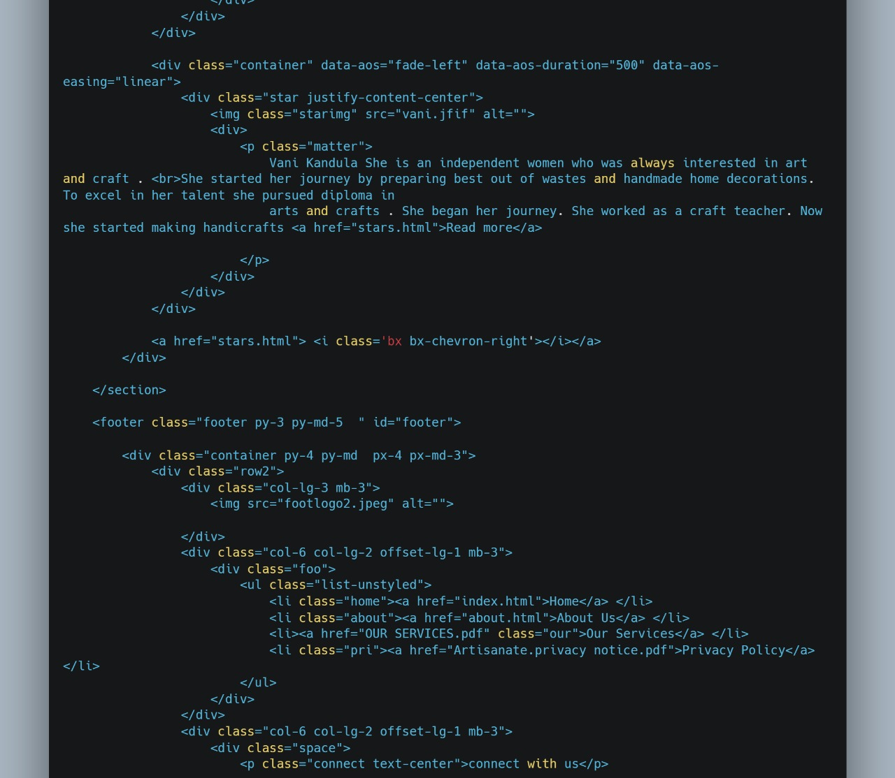

Slide 15
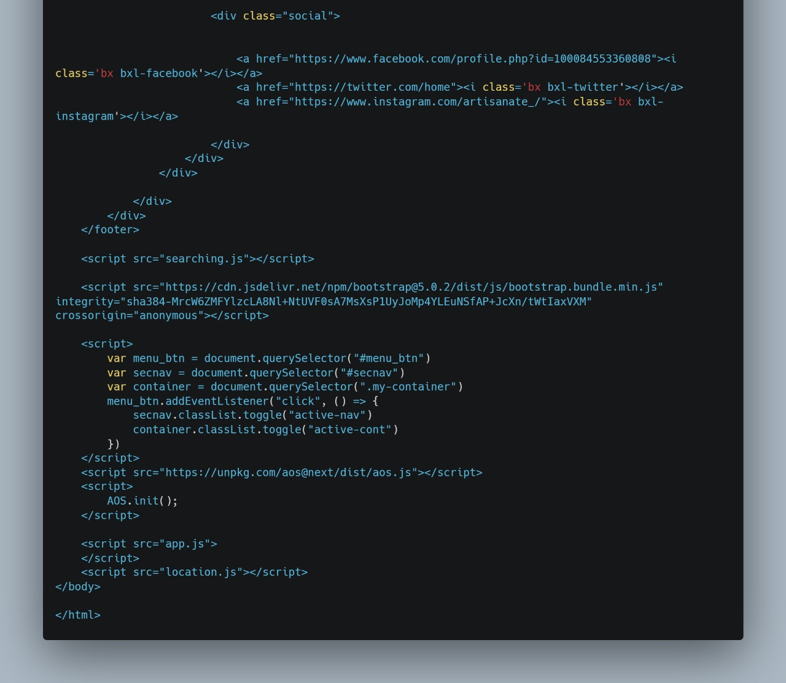

Slide 16
Future developments
We intend to make the website fully dynamic.We would like to develop the website in such a way that the user will be able to publish their products on their own .We would like to introduce online payment methods . We would also like to add filters to products ranging from high to low and low to high. We could add image processing to make sure that the products wont be duplicated.
References
HTML : https://youtu.be/UB1O30fR-EE
CSS : https://youtu.be/yfoY53QXEnI
Bootstrap : https://youtu.be/5GcQtLDGXy8
Animations : https://youtu.be/ptfUwPJbGlQ
Firebase
https://firebase.google.com/docs/database?authuser1
https://www.youtube.com/watch?v=VXWmJsv1Vh4&t=18s
https://www.youtube.com/watch?v=H8frPNjKSC8&t=413s

